Slide 1

A Multipath QUIC Scheduler
for Mobile HTTP/2
Jing Wang, Yunfeng Gao, Chenren Xu
Peking University
jing.wang@pku.edu.cn
Notes:
Hello, I am Jing Wang, a second year phd student from Peking University. I did this work with Yunfeng Gao, and my advisor chenren Xu.
today I am going to show you a multipath quic scheduler, basically a packet scheduler optimizing mobile browsing.
←→
✓✗
✕
⓪ ① ② ③ ④ ⑤ ⑥ ⑦ ⑧ ⑨ ⑩ ⑪ ⑫ ⑬ ⑭ ⑮⑯ ⑰ ⑱ ⑲ ⑳
⓵⓶⓷⓸⓹⓺⓻⓼⓽⓾
❶❷❸❹❺❻❼❽❾❿⓫⓬⓭⓮⓯⓰⓱⓲⓳⓴
➊ ➋ ➌ ➍ ➎ ➏ ➐ ➑ ➒ ➓
Ⓐ Ⓑ Ⓒ Ⓓ Ⓔ Ⓕ Ⓖ Ⓗ Ⓘ Ⓙ Ⓚ Ⓝ Ⓞ Ⓟ Ⓠ Ⓡ ⓈⓉ Ⓤ Ⓥ Ⓦ Ⓧ Ⓨ Ⓩ
http://www.unicode.org/charts/beta/nameslist/n_2460.html
http://xahlee.info/comp/unicode_circled_numbers.html

Slide 2
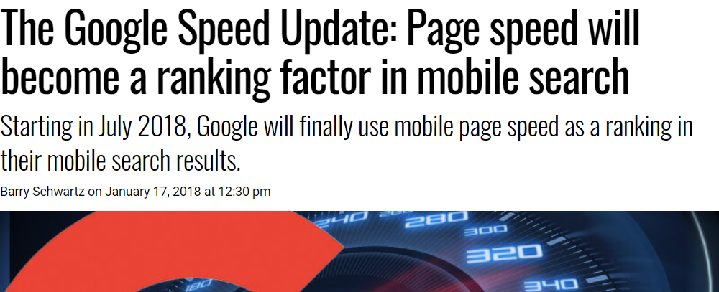
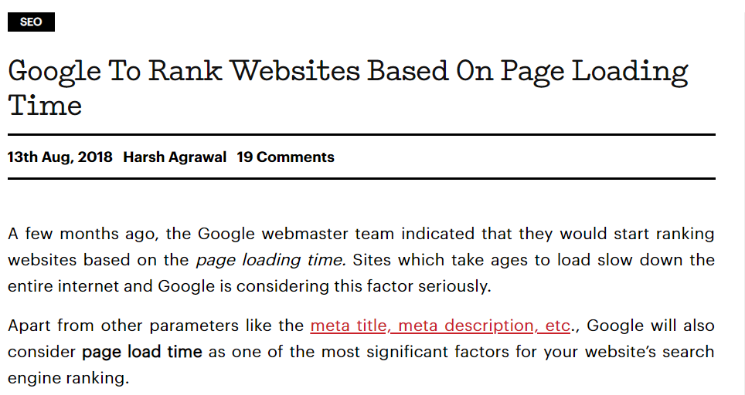
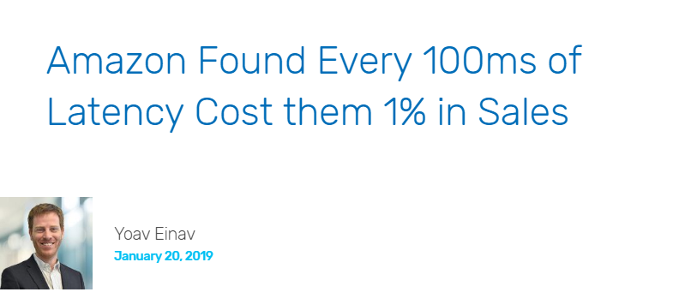
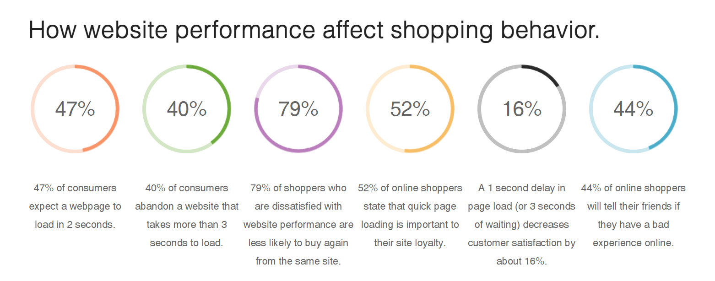
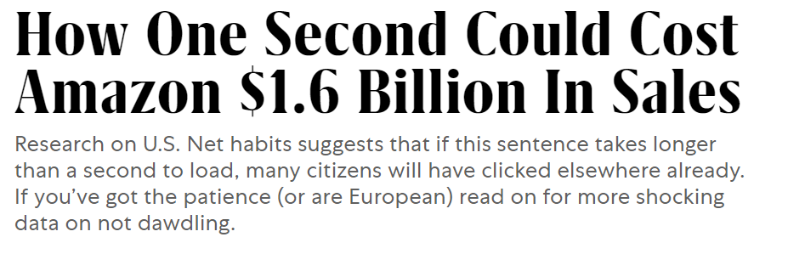
Mobile Browsing
Generates more HTTP traffic than desktop browsing
Up to 70% of web traffic happens on mobile devices
40% of people search only on a smartphone
Page Load Time
500 ms can decrease up to 20% traffic
Slow pages get lower search rankings
Slow pages generate less revenue
Notes:
Why did we focus on mobile browsing?
According to recent statistics, Mobile browsing has been generating even more HTTP traffic than desktop browsing
During the last year, Up to 70% of web traffic happens on a mobile device, and 40% of people search only on a smartphone
Page Load Time is a very important metric for web browsing.
Google reported that delay significantly reduced the number of searches, an extra delay of 500 milliseconds can decrease up to 20% traffic for some popular content provider.
Slow pages will also get lower search rankings and generate less revenue.

Slide 3

Web Browsing Pattern
http://index.html
foo.js
bar.js
<html>
...
<script>foo.js</script>
<script>bar.js</script>
...
</html>
...
var image = new Image();
image.src = “img1.jpg";
document.appendChild(image);
...
...
var image = new Image();
image.src = “img2.jpg";
document.appendChild(image);
...
② Parse
HTML
④ Execute
foo.js
⑤ Execute
bar.js
client
Network
① GET index.html
HTML
③ GET foo.js
Bar.js
JS
JS
⑤ GET img1.jpg
⑥ GET img2.jpg
IMG
IMG
CPU
Both
server
Cellular Network
Low Bandwidth
Mobile Devices Limited CPU
Poor CPU/network Utilization
Notes:
Let’s start with a toy example illustrating web browsing pattern.
We want to browse a page, its html contains 2 javascrips, in each of the javascrips, a corresbonding image should be downloaded.
How does a browser load this page?
First, it sends a request to server to get the html, after getting the html, it will parse the html and know there are 2 js needed. So it sends another request. When the first js comes, the browser will execute the js and get to know it should download an img. During the execution time, the second js arrives, but it should wait for the execution of the first js. Only after the first js finishes transfer will the browser be able to execute the second js and request the img. After the execution of the second js, it will request the second img. After a while, the two imgs arrive, and the client finishes downloading resources.
As we all know, mobile devices have limited CPU power comparing to desktop devices, and cellular network may have low bandwidth. During the whole approach, CPU and network only work in parallel in a very short time. it leads to poor CPU and network utilization.
the client CPU is the primary bottleneck when loading web pages
Recent studies have found that dependencies between the resources on any web page are a key reason for
slow page loads. Today, even mobile-optimized web pages include
roughly one hundred resources [ 7 ] on average, and client browsers
can discover each of these resources only after they have fetched,
parsed, and executed other resources that appear earlier in the page.
For instance, a browser may learn that it needs to fetch an image
after executing a script which it discovers after downloading and
parsing the page’s HTML.

Slide 4
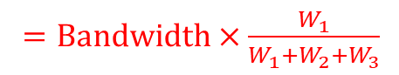
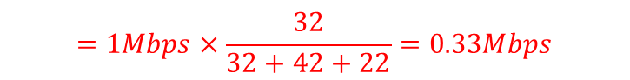
Dependency Tree in HTTP/2
Not all messages are of equal importance
Stream dependencies
Weights: relative proportion of available resources
Bandwidth allocated to S1
$=Bandwidth×\frac{W_{1}}{W_{1}+W_{2}+W_{3}}$
$$=1Mbps×\frac{32}{32+42+22}=0.33Mbps$$
0
32
S1: 0.8MB
42
22
S1: 1.2MB
1 Mbps
S2: 1MB
S3: 0.6MB
1
2
3
S3: 0.5MB
S3: 0.9MB
Java Script
2 MB
Font
1 MB
Image
2 MB
Time
0s
2.3s
4.4s
5s
Notes:
This is only a toy example, nowadays, a real page needs hundreds of rescoures to be downloaded.
Obviously, not all those messages are of equal importance. HTTP/2 defines a priority mechanism called dependecy tree. Here’s an example. There are four nodes here.node 0 is the root node and has no data to transfer, and it has three children nodes which are a js, a font file and an img.
Stream dependencies are described as links, the children nodes can only transfer their data after their parent node completes data transfer.
Each dependency is assigned a relative weight, a number that is used to determine the relative proportion of available resources that are assigned to streams dependent on the same stream. Suppose we allocate 1 Mbps to node 0, how much bandwidth should we allocate to S1?
The bandwidth allocated to S1 should be the bandwidth allocated to its parent times by its weight proportion, which is its own weight divided by the sum weight of its sibling nodes.
At the beginning, it gets one third of its parent’s bandwidth, after S2 completes, S1 will share the bandwidth with S3. when S1 completes, S3 can use all the bandwidth.
Weights here describe the relative proportion of available resources.
The purpose of prioritization is to allow an endpoint to express how it would prefer its peer to allocate resources when managing concurrent streams.
Streams can be prioritized by marking them as dependent on the completion of other streams. Each dependency is assigned a relative weight, a number that is used to determine the relative proportion of available resources that are assigned to streams dependent on the same stream.

Slide 5
Exclusive delivery
S1: 0.8MB
S1: 1.2MB
1 Mbps
S2: 1MB
S3: 0.6MB
S3: 0.5MB
S3: 0.9MB
Time
0s
2.3s
4.4s
5s
1 Mbps
S2: 1MB
S1: 2MB
S3: 2MB
Time
1s
3s
5s
Notes:
What if we can apply exclusive delivery?
Although it wont reduce the total download time, the previous streams can complete transfer earlier, thus the browser can execute or display them to users earlier. In this way, it shows the potential of improving user experience.

Slide 6

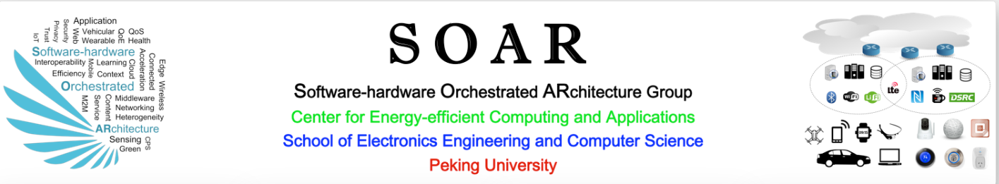
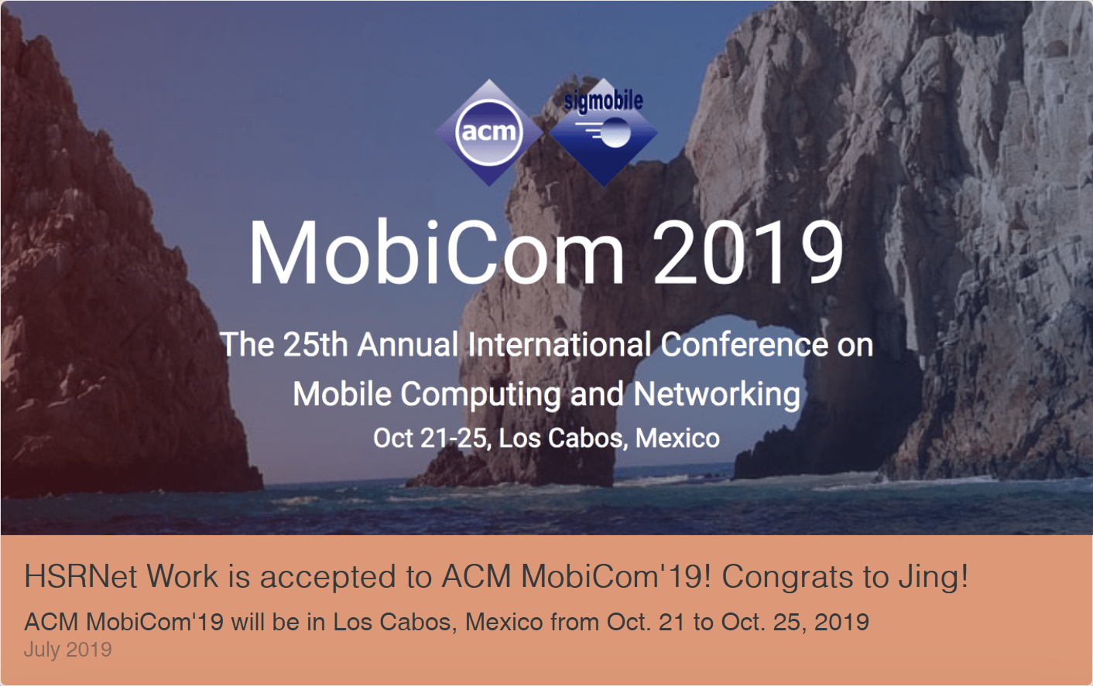

Goal of our work
Toy Example
Potential of Reducing Object Completion Time
Intuition:
Prioritize rendering resources
☺ Utilize HTTP/2 dependency tree
Aggregate bandwidth of multiple interfaces
☺ Apply multipath transport protocol
Improve CPU/network utilization
☺ Reduce object completion time
Challenges
Fairness VS. Efficiency
Path heterogeneity especially on mobile devices
Path Loss
Loading…
Loading…
https://soar.group
Notes:
What can we do to optimize mobile browsing? We have several intuitions.
First, we could prioritize rendering resources by utilizing Http/2 dependency tree.
Next, usually mobile devices have multiple interfaces, we can aggregate their bandwidth by applying multipath transport protocol.
At last but not least, we could improve the CPU and network utilization by reducing object completion time, we can achieve this by applying exclusive delivery. Here’s an example illustrating the potential of exclusive delivery.
Here’s an animation, if two people want to browse our homepage , they click the url at the same time, the person using the phone on the right side will see the icon of our group first, then the news about I published a paper on mobicom then the news that my advisor was invited to organize rising stars forum of mobisys this year. So although the PLD on the two smartphones are the same, but the person using the phone on the right side would definitely have better user experience.
But it’s not easy to achieve those goals, there are several challenges here.
First of all, speaking of scheduling, there is always a tradeoff between fairness and efficiency .
And Path heterogeneity often causes performance degradation for multipath protocols on mobile devices.
Path loss is also a challenge for MP protocol, since it can cause head-of-line blocking problem

Slide 7
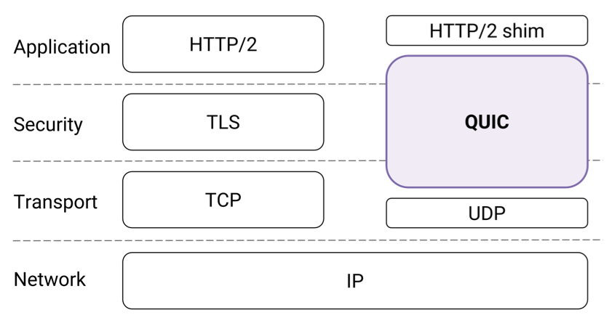
QUIC Background
Transport layer network protocol
Facilitate rapid deployment
Improve performance for HTTP traffic
Reduce handshake time (0-RTT)
Prevent head-of-line blocking
Improve loss recovery
HTTP-over-QUIC became HTTP/3
Notes:
The first thing we need to do is to choose a multipath protocol. We chose the MPQUIC.
Let’s start with a brief introduction of QUIC.
QUIC is a transport layer network protocol initially developed by Google.
It collapses the functions of the classical HTTP/2, TLS and TCP protocols into a single application layer protocol that runs over UDP.
Since it's an application layer protocol, it can facilitate rapid deployment.
The payload of a QUIC packet contains one or more frames. Frames carry stream data and control information while QUIC packets act as their "containers”.
in November 2018, fellow IETF members gave their official approval that HTTP-over-QUIC became HTTP/3

Slide 8
MPTCP vs. MPQUIC
MPQUIC outperforms MPTCP
Quentin De Coninck, et al. Multipath QUIC: Design and Evaluation. In ACM CoNEXT, 2017.
MPTCP
Decide which data will be sent on which path
Forced to (re)transmit data in sequence over each path
MPQUIC
Also determines which control frame will be sent on which path
Retransmission strategy is more flexible
Stream details known at arrival time
Size of each stream
Priority information from HTTP/2
Notes:
MPQUIC is a multipath extension of QUIC.
According to the work published in Conext 2017, performance of single-path TCP and single-path QUIC are similar, while MPQUIC can outperform MPTCP. In lossy scenarios, (MP)QUIC is more suited than (MP)TCP.
Multipath QUIC uses the same STREAM frames as QUIC to carry data, and Frames are independent of the packets carrying them.
MPTCP has to decide which data should be sent on which path, MPQUIC further needs to determine which control frame will be sent on which path. This provides us the opportunity for uplink ACK scheduling.
When a packet is marked as lost, MPTCP is forced to (re)transmit data in sequence over each path to cope with middleboxes. However, in mpquic, its frames are not necessarily retransmitted over the same path. Thus Retransmission strategy is more flexible in MPQUIC than in MPTCP.
What’s more, MPQUIC inherently knows the stream details when streams arrive.
The details include the size of each stream and priority information from above layers, which enables us to do fine-grained scheduling.

Slide 9
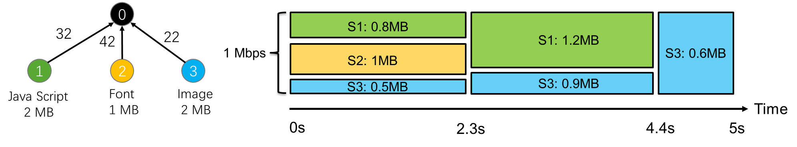
Downlink Scheduler Design
Ordered set of streams
Set of streams
Stream
ordering
Stream
scheduling
Exclusive delivery
Fair Schedulers
Weighted Round Robin (WRR), Deficit Round Robin (DRR), Weighted Fair Queuing (WFQ)
Calculate Stream Completion Order
Goal: For each stream
Complete transfer on all paths simultaneously
Steps
Select a stream according to the ordering
For this stream, allocate byte quotas on all paths
Considering RTT, bandwidth, queuing time
Update total queuing time for each path
Loop to step 1
S2, S1, S3
Notes:
Next, we designed a downlink scheduler to reduce the average stream completion time.
To begin with, we have a set of streams to be transferred, first we do the stream ordering.
There has already been several fair schedulers that can allocate resources proportionally to guarantee fairness.
The streams will complete in a specific order with the fair schedulers. If we achieve the same completion order with those fair schedulers, we can achieve the same fairness with them.
For example, the stream completion order here should be S2, S1,S3
Now we have an ordered set of streams, and it’s time to do the stream scheduling.
Our goal for each stream is to make it complete transfer on all paths simultaneously in order to make it complete transfer as soon as possible to reduce stream transfer time.
We need a few steps to achieve this. First, we select a stream according to the ordering, for example, we should choose S2 first, then S1, and S3 at last.
For the selected stream, we allocate byte quotas to be sent on all paths, to make it complete transfer on all paths simultaneously. Here we consider path bandwidth, RTT, and queuing time of previous allocated streams.
Then we update total queuing time for each path and loop to step one to process the next stream.
After the scheduling, we delivery the streams as scheduled,
we have already achieved exclusive delivery, since each stream is to be completed on all paths simultaneously, so at any time, there will only be one stream transfered to client.

Slide 10



Uplink Scheduler Design
Data 1
10 ms
Data 1
10 ms
10 ms
ACK 1
10 ms
ACK 1
ACK 2
Data 2
50 ms
Data 2
50 ms
Server
Server
50 ms
50 ms
ACK 2
RTT = 100 ms
RTT = 60 ms
Send ACK on the faster path
Step 1: Estimate uplink delay
Step 2: Change ACK Return Path
Notes:
12:00
We also see opportunities for uplink scheduler.
Suppose we are using a mobile phone with two interfaces and the network conditions of the two paths are very different.
It is very important because congestion control algorithm usually use RTO to detect packet loss, and RTO(retransmission time out) is highly related to RTT of each path. Reducing RTT for slower path can speed up loss detection and recovery.
Our basic idea is to send ACK on the faster path.
The first step is to estimate uplink delay, We achieve this by sending duplicate ACK on all paths periodically. After sever receives all the ACK packets, it gets to know which path is slower and which path is faster. Then it tells the client to change ACK return path by sending a control frame.

Slide 11



Evaluation Methodology
Websites with different sizes and number of resources
Simulation: Mininet + mpquic-go
Real-world Setup
HETEROGENEITY | PATH 1 | PATH 2
Low | 5 Mbps Bandwidth, 10 ms OWD, 0 PLR | 5 Mbps Bandwidth, 10 ms OWD, 0 PLR
Low and Lossy | 5 Mbps Bandwidth, 10 ms OWD, 2% PLR | 5 Mbps Bandwidth, 10 ms OWD, 2% PLR
High | 3 Mbps Bandwidth, 10 ms OWD, 0 PLR | 7 Mbps Bandwidth, 50 ms OWD, 0 PLR
High and Lossy | 3 Mbps Bandwidth, 10 ms OWD, 2% PLR | 7 Mbps Bandwidth, 50 ms OWD, 2% PLR
Low
High
Aggregated bandwidth = 10 Mbps
214 ± 54 ms
WLAN
Internet
LTE
MPQUIC
Client
78 ± 30 ms
Alibaba Cloud
Notes:
So far, we have proposed an uplink and downlink co-designed scheduler prototype, and validated it by using the snapshots of two famous websites with different sizes and number of resources. the websites are google and amazon.
We first did the simulation experiments on mininet with mpquic-go. Mininet is a platform which can simulate specific network topologies.
Here we consider 4 cases including different path heterogeneity levels. we also consider the path loss. We keep the aggregated bandwidth to 10 Mbps to focus on path heterogeneity and path loss.
We also used a real-world setup to validate. We deployed web snapshots with MPQUIC on Alibaba cloud server, and we use a laptop connects to wifi through Cernet (china education and research network ) and access LTE through a commodity cell phone.

Slide 12
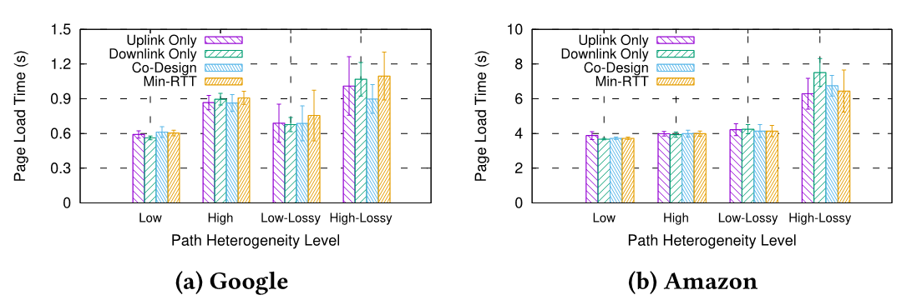
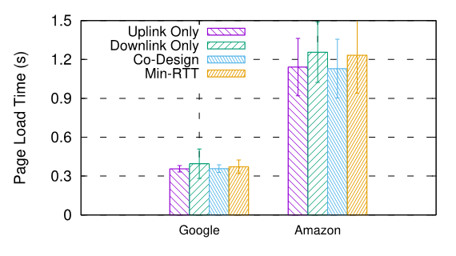
Page Load Time (PLT)
Mininet
Real world
85.9 ms
155.3 ms
92.2 ms
40.5 ms
8.0 ms
15.5 ms
Take away messages
1) Uplink scheduler benefits more in lossy & heterogeneous scenarios
2) Downlink scheduler doesn’t significantly reduce PLT
Notes:
We evaluate our stand-alone uplink/downlink scheduler and the co-designed scheduler.
The page load time here is the time from the initial request sent by the client to the completion of all the resources.
The left two figures are the experiments on mininet with each cluster denotes a different path heterogeneity level. The right figure is generated by our real world setup, with each cluster denoting a web site.
If we compare the uplink only scheduler with the baseline min-RTT scheduler, we can see our uplink scheduler can reduce PLT in heterogeneous scenarios, and benefits more when packet loss exists.
Our downlink scheduler doesn’t significantly reduce PLT, because we didn’t consider the CPU processing here, and it focuses on stream completion time reduction.

Slide 13
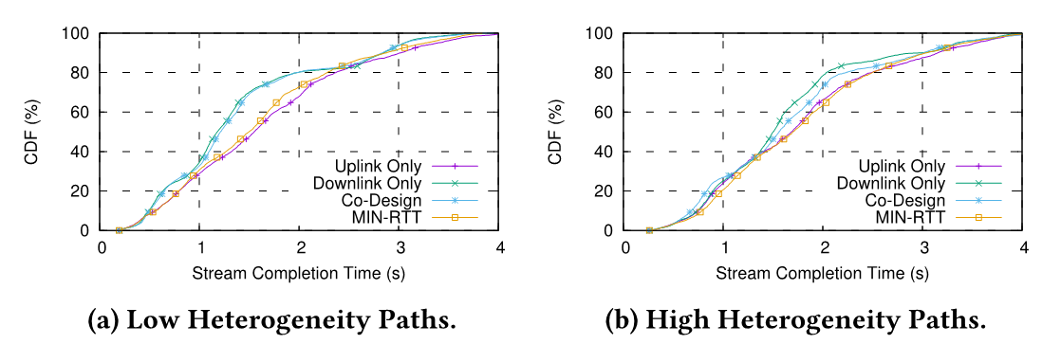
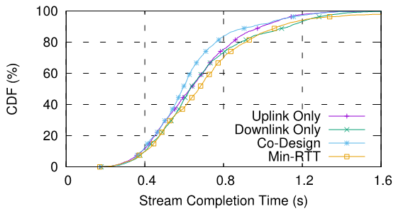
Stream Completion Time (SCT)
Mininet
Real world
10.9%
6.5%
12.9%
Downlink scheduler and Co-Designed scheduler
can reduce average SCT
Notes:
15:30
For the stream completion Time, we put all the streams from google and amazon together in each case and draw the CDF(Cumulative distribution function) of stream completion Time.
We can see from our results that our downlink scheduler and co-designed scheduler can reduce average Stream completion time. And our co-designed scheduler can benefit more from real world setup, Because in real world, the network usually fluctuates, and our uplink scheduler can help reduce the RTT of the slower path and make downlink scheduler estimate RTT and Bandwidth more accurately.

Slide 14
Conclusion & Future Work
Conclusion
MPQUIC provides opportunities for finer-grained scheduling
Uplink scheduler can speed up loss recovery
Downlink scheduler benefits from stream information
Future Work
How much can a browser benefit from stream completion time reduction?
Integrate our work into Chromium
Reduce Page Load Time by optimizing dependency tree.
Notes:
From our work, we can see MPQUIC provides opportunities for finer-grained shceduling.
Uplink scheduler can speed up loss recovery.
Downlink scheduler can benefit from stream information provided by MPQUIC
Up to now, we have only designed the scheduler prototype and validated it.
In future, we will explore how much a real browser can benefit from the reduction of stream completion time.
We only implemented our prototype on mpquic-go, we will integrate our work into chromium.
Furthermore, We see the opportunity to reduce page load time by optimizing dependency tree.

Slide 15
Thanks Q&A

Slide 16
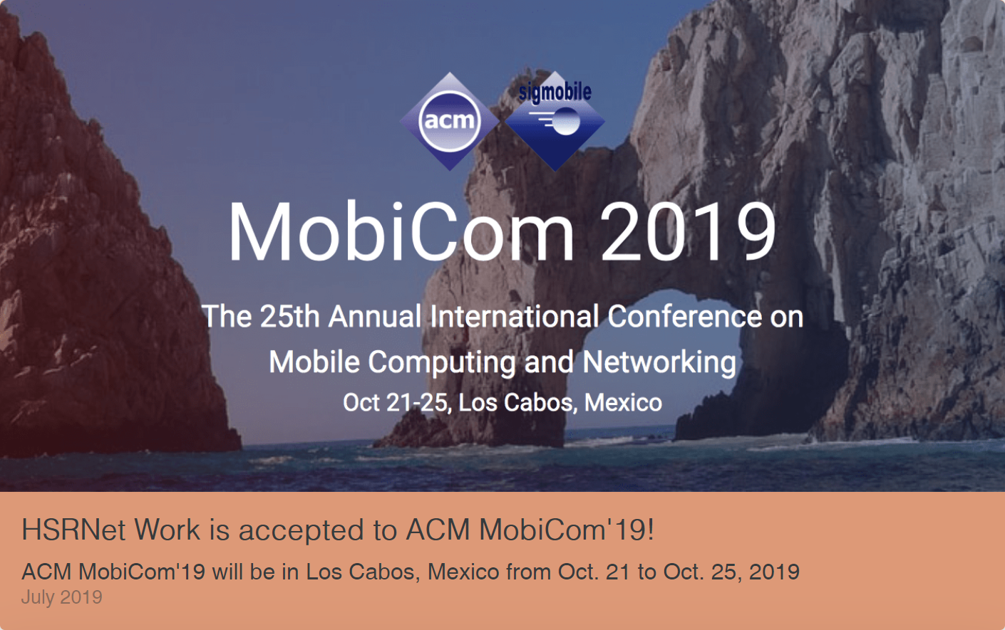
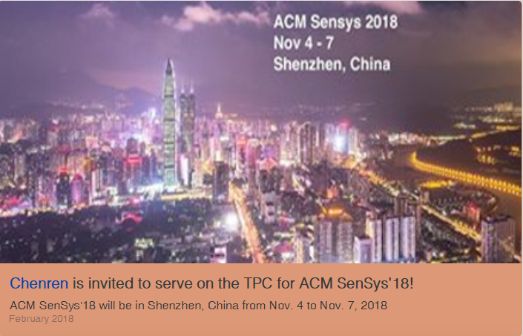
Goal of our work
Toy Example
Potential of Reducing Object Completion Time
Intuition:
Prioritize rendering resources
☺ Utilize HTTP/2 dependency tree
Aggregate bandwidth of multiple interfaces
☺ Apply multipath transport protocol
Improve CPU/network utilization
☺ Reduce object completion time
Challenges
Fairness VS. Efficiency
Path heterogeneity especially on mobile devices
Path Loss
Loading…
Loading…
Notes:
What can we do to optimize mobile browsing?
We have several intuitions. First, we could prioritize rendering resources by utilizing Http/2 dependency tree.
Next, usually mobile devices have multiple interfaces, we can aggregate their bandwidth by applying multipath transport protocol.
At last but not least, we could improve the CPU and network utilization by reducing object completion time, we can achieve this by applying exclusive delivery. Here’s an example illustrating the potential of exclusive delivery. Here’s an animation, if two people want to browse the homepage of our group, they click the url at the same time, the person using the phone on the right side will see the icon of our group first, then the news about I published a paper on mobicom then the news the my advisor was invited to be a TPC while loading the page,. So although the PLD on the two smartphones are the same, but the person using the phone on the right side has better user experience.
But it’s not easy to achieve those goals, there are challenges here.
First of all, speaking of scheduling, there is always a tradeoff between fairness and efficiency .
And Path heterogeneity often cause performance degradation for multipath protocols on mobile devices.
Path loss is also a challenge for MP protocol, since it can cause head-of-line blocking problem

Slide 17

Goal of our work
Toy Example
Potential of Reducing Object Completion Time
Intuition:
Prioritize rendering resources
☺ Utilize HTTP/2 dependency tree
Aggregate bandwidth of multiple interfaces
☺ Apply multipath transport protocol
Improve CPU/network utilization
☺ Reduce object completion time
Challenges
Fairness VS. Efficiency
Path heterogeneity especially in mobile devices
Path Loss
Loading…
Loading…

Slide 18
Question might be asked
The influence of different domains
The client requests all objects from server ->to make the server better

Slide 19
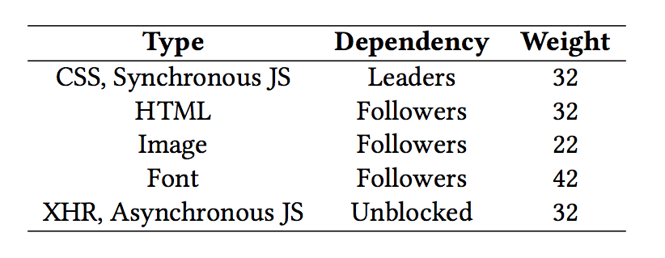
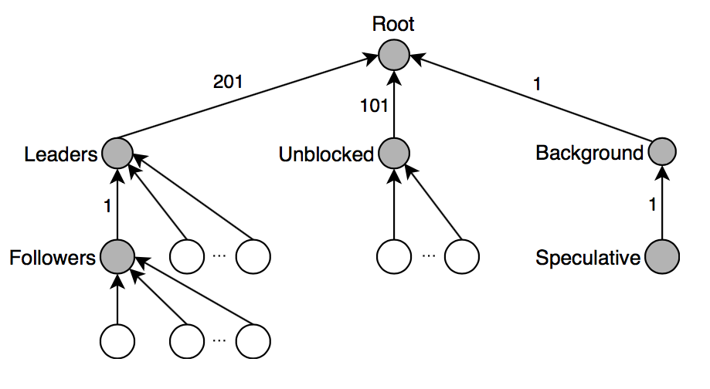
Firefox style dependency tree layout
Notes:
The purpose of prioritization is to allow an endpoint to express how it would prefer its peer to allocate resources when managing concurrent streams.

Slide 20
Challenges
Fairness VS. Efficiency
Path heterogeneity especially in mobile devices
Path Loss
Schedulers
Which data should be sent in next data packet
Which path shall the packet be sent on

Slide 21
MPQUIC
QUIC
More flexible and efficient loss detection and recovery mechanism
Eliminate head-of-line blocking
MPQUIC
MPQUIC outperforms MPTCP
Quentin De Coninck, et al. Multipath QUIC: Design and Evaluation. In ACM CoNEXT, 2017.
Stream details known at arrival time
Size of each stream
Priority information from HTTP/2
Notes:
The first thing we need to do is to choose a multipath protocol. We chose the MPQUIC.
QUIC is a reliable transport protocol designed by google.
It’s more flexible and efficient in loss detection and recovery and can partially eliminate head-of-line blocking by mutiplexing streams.
MPQUIC is a multipath extension of QUIC, and outperforms MPTCP especially when the paths are heterogeneous.
performance of single-path TCP and single-path QUIC are similar, MPQUIC can outperform MPTCP. In lossy scenarios, (MP)QUIC is more suited than (MP)TCP.

